Slide 1
Job Satisfaction Analysis: Exploring Work Environment, Health, and Career Growth
50%
— A Data-Driven Approach to Improve Employee Retention and Productivity
Group 11B：
Shyam Desai
Yining Yang
Adya Yerradoddi
Yizhen Cao
Shih Ching Wang

Slide 2
Introduction
Overview
This project explores how employees' life experiences—both inside and outside the workplace—affect job satisfaction
Key Objectives
Goal
Assess the relationship between job satisfaction and variables like work-life balance, environment satisfaction, and health status.
01
Provide actionable insights for improving employee retention and productivity strategies.
02
Use predictive models to forecast job satisfaction levels.
03
Analyze demographic and department-level effects on satisfaction.

Slide 3
Dataset Exploration
Initial Insights：
Data obtained from the Kaggle Employee Survey Dataset.
Comprehensive dataset focusing on job satisfaction and related factors.
Includes demographic attributes, work environment ratings, health metrics, and performance data.
Inspected for missing values, outliers, and inconsistencies.
Performed exploratory analysis (EDA) conducted to understand structure and trends.
Variable Types:
Dependent Variable: Job Satisfaction
Categorical: Gender, Department, Education Level, Employment Type.
Continuous: Age, Experience, Commute Distance, Training Hours.
Scale (1-5): Stress, Workload, Job Satisfaction, Work-Life Balance.

Slide 4
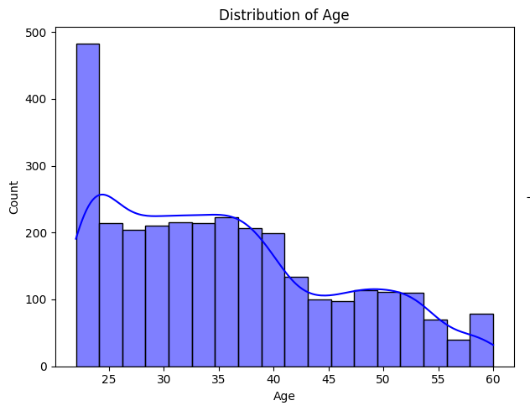
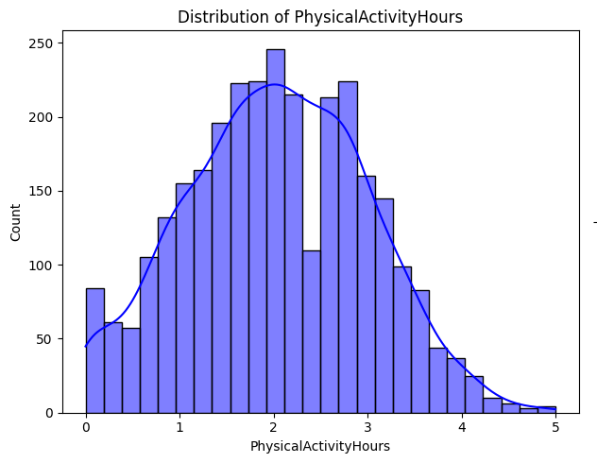
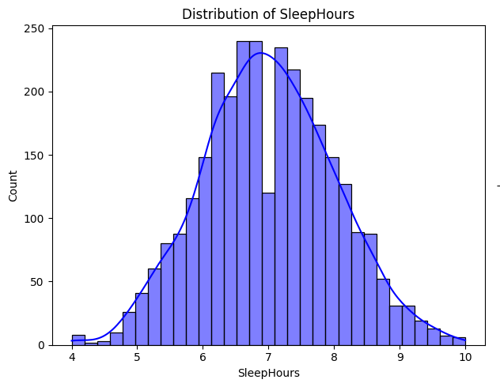
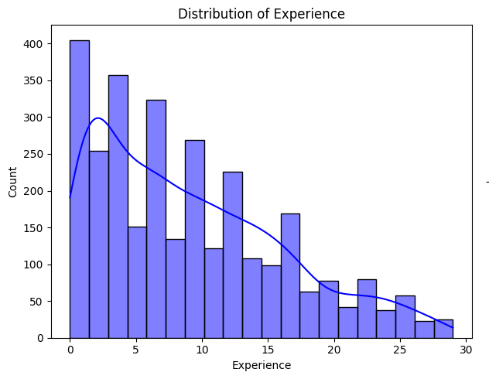
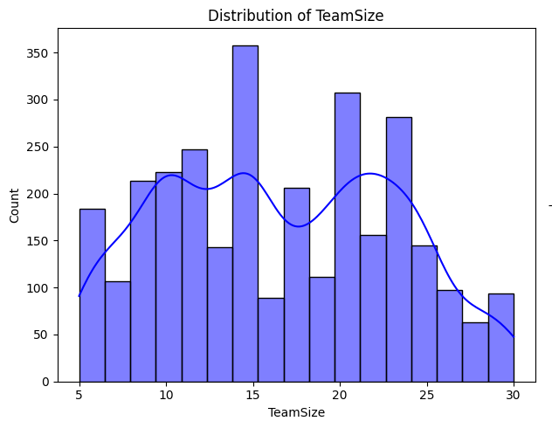
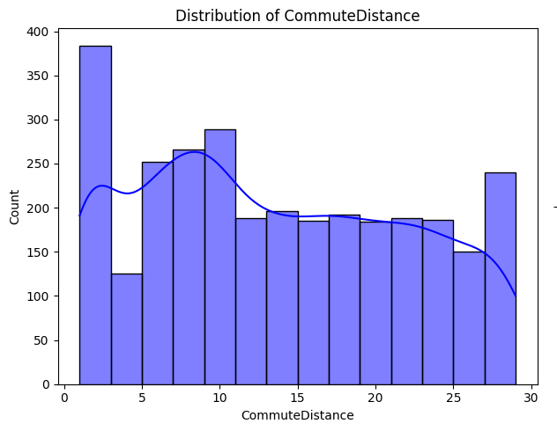
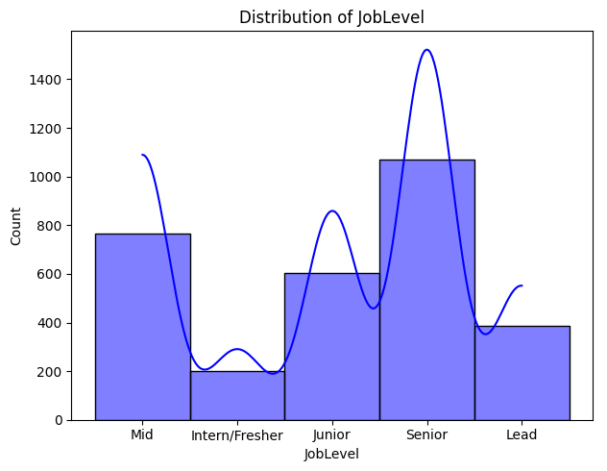
Exploratory Data Analysis
These distributions provide a snapshot of the dataset, helping identify employee demographics and potential factors influencing job satisfaction.
Most employees are aged between 25 and 35 years.
The majority of employees report 2–4 hours of physical activity per week.
Sleep hours center around 7–8 hours, reflecting healthy sleep habits.
Most employees have 3–10 years of work experience.
Team sizes vary widely, with peaks around 10, 15, and 25 members.
Most employees commute short distances (5–15 km).
Employees are evenly distributed across junior, mid, and senior levels.

Slide 5
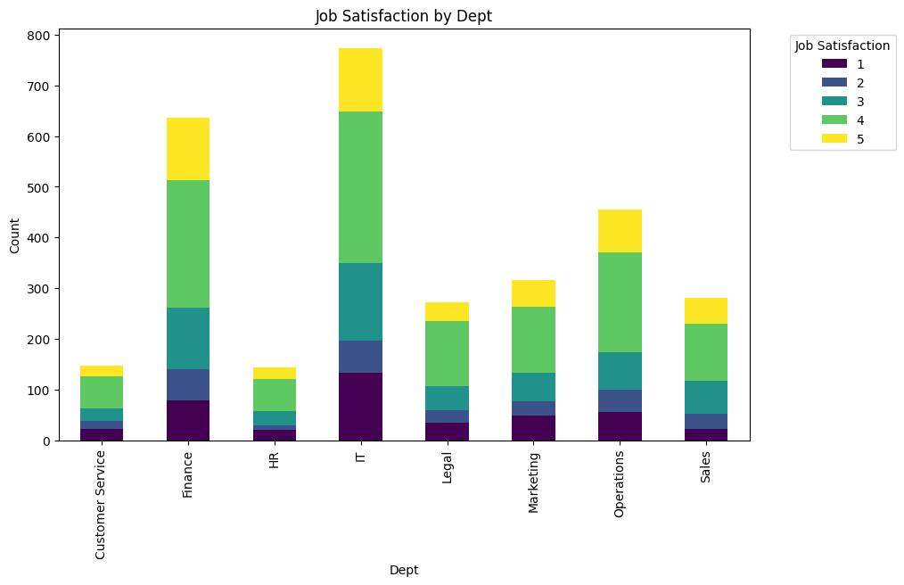
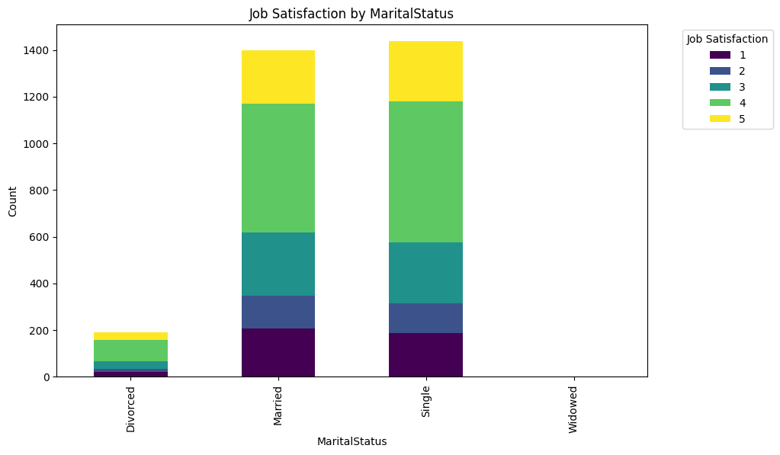
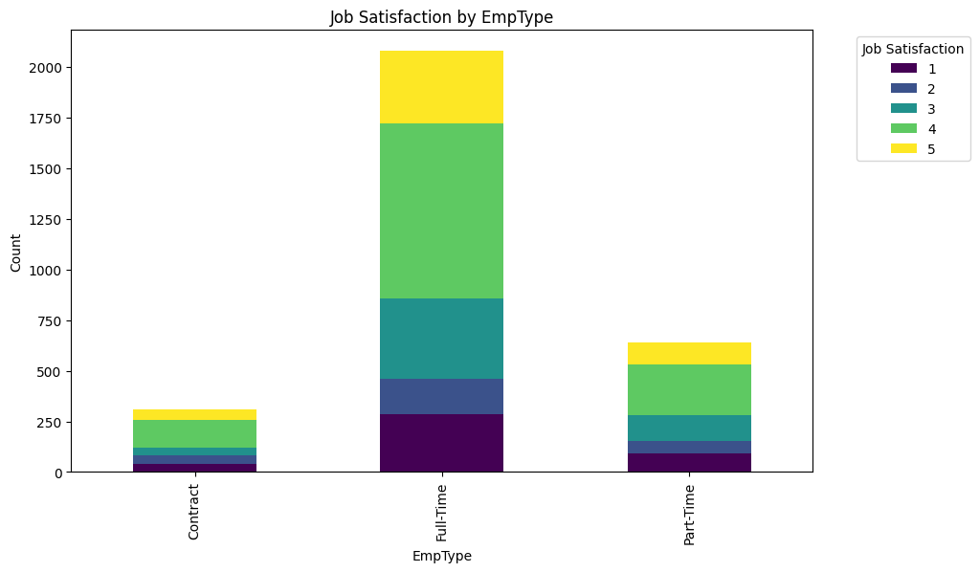
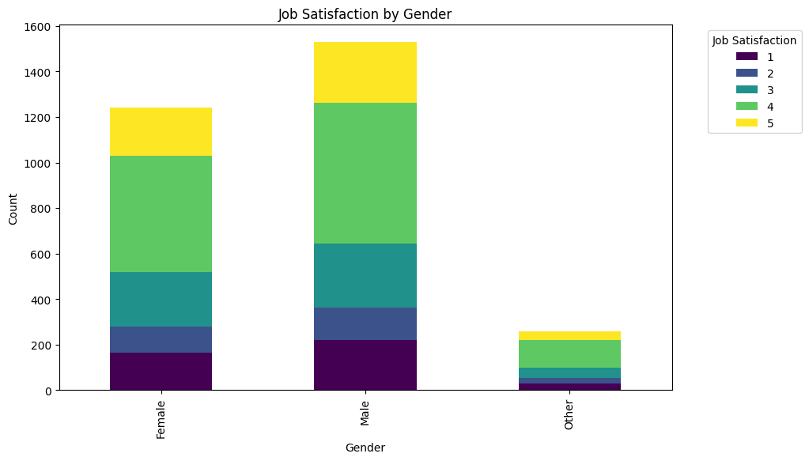
How to be most satisfied with your job?
By being single or married male, working a full-time job in IT or Finance department!
Notes:
How can you be most satisfied at your job?
By being a married or single male, working a full time job in IT or Finance department!

Slide 6
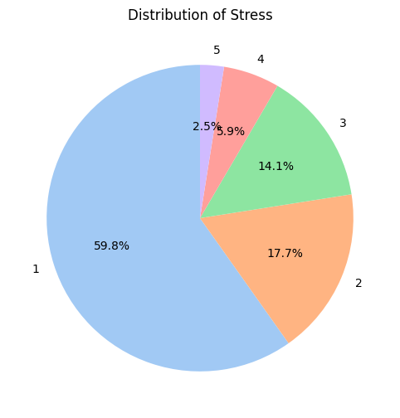
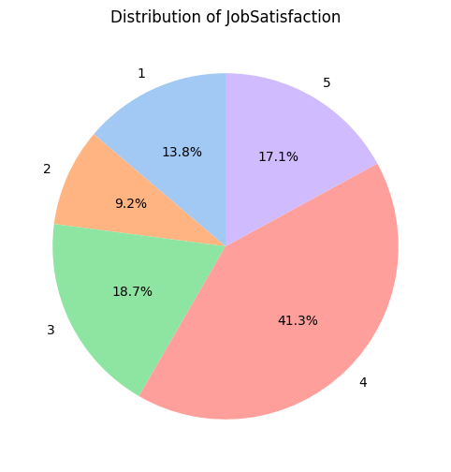
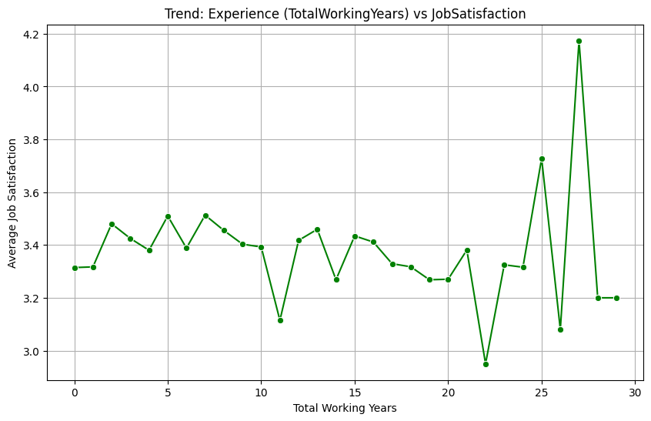
Distribution of Stress
1 is lowest and 5 is highest
Majority employees encounter minimal stress.
About 1/3rd employees face moderate stress levels
Distribution of Job Satisfaction
Job satisfaction is generally high, with 41.3% of employees rating it as 4 and 17.1% rating it as 5.
Lower satisfaction ratings (1 and 2) account for a smaller proportion (13.8% and 9.2%, respectively).
Key Insights:
Job satisfaction tends to fluctuate slightly with years of experience.
Employees with less than 10 years and 25+ years of experience show higher average satisfaction scores.
Satisfaction dips between 10 –25 years of experience, possibly indicating challenges or stagnation during mid-career.
The peak satisfaction at 25+ years suggests greater stability and fulfillment in later career stages.
Notes:
Distribution of Stress
Key Insights:
Majority of employees (59.8%) report a stress level of 1, indicating low stress.
Only 2.5% of employees report a stress level of 5, suggesting very high stress is uncommon.
Moderate stress levels (2 and 3) account for approximately 31.8% of employees.
Distribution of Job Satisfaction
Key Insights:
Job satisfaction is generally high, with 41.3% of employees rating it as 4 and 17.1% rating it as 5.
Lower satisfaction ratings (1 and 2) account for a smaller proportion (13.8% and 9.2%, respectively).
These results suggest that most employees are relatively satisfied with their jobs.
Trendline
Key Insights:
Job satisfaction tends to fluctuate slightly with years of experience.
Employees with less than 5 years and 25+ years of experience show higher average satisfaction scores.
Satisfaction dips between 5–20 years of experience, possibly indicating challenges or stagnation during mid-career.
The peak satisfaction at 25+ years suggests greater stability and fulfillment in later career stages.

Slide 7
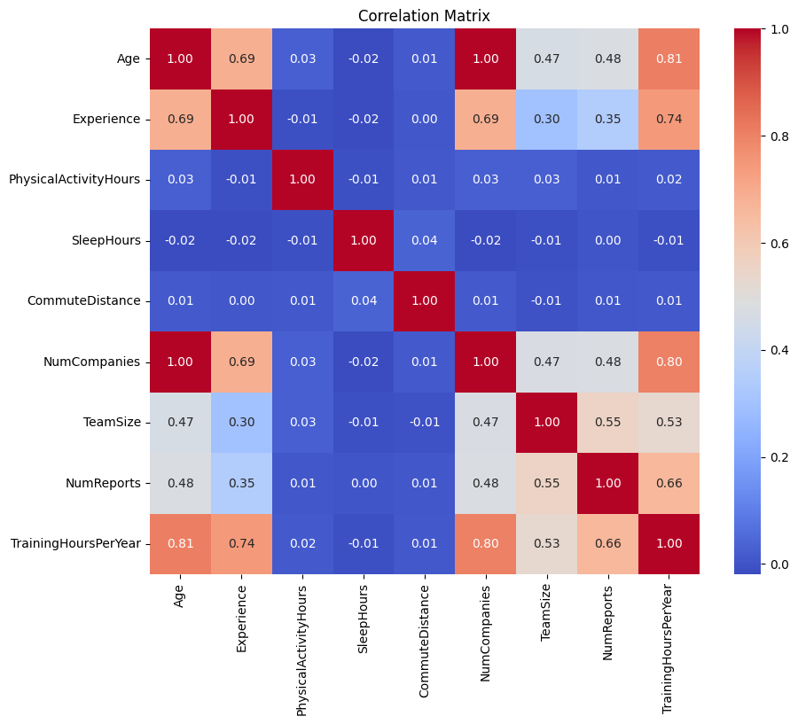
Relationships Between Various Variables
Age and Experience
Strong positive correlation (0.69) indicates that as employees age, they tend to have more work experience.
Experience and Training Hours
Moderate positive correlation (0.74) shows that experienced employees are more likely to receive training.
Team Size and Number of Reports
Positive correlation (0.55) suggests that larger teams often involve more reporting responsibilities.
Age and Training Hours
Strong correlation (0.81) suggests older employees participate in more training programs, possibly reflecting senior roles.
Physical Activity and Other Variables
Minimal correlation with other variables, indicating independence of physical activity levels from work-related factors.
Notes:
Key Pointers
Age and Experience:
Strong positive correlation (0.69) indicates that as employees age, they tend to have more work experience.
Experience and Training Hours:
Moderate positive correlation (0.74) shows that experienced employees are more likely to receive training.
Team Size and Number of Reports:
Positive correlation (0.55) suggests that larger teams often involve more reporting responsibilities.
Age and Training Hours:
Strong correlation (0.81) suggests older employees participate in more training programs, possibly reflecting senior roles.
Physical Activity and Other Variables:
Minimal correlation with other variables, indicating independence of physical activity levels from work-related factors.
Commute Distance:
Weak correlations with all other variables suggest commute distance does not strongly interact with job-related factors.
Summary:
This correlation matrix helps identify strong and weak relationships between variables, guiding feature selection for further analysis. Variables like Age, Experience, and Training Hours are key influencers in this dataset.

Slide 8
Machine Learning Analysis
01
Random Forest
02
XGBoost
ML Models
03
Logistic Regression
04
SVM

Slide 9
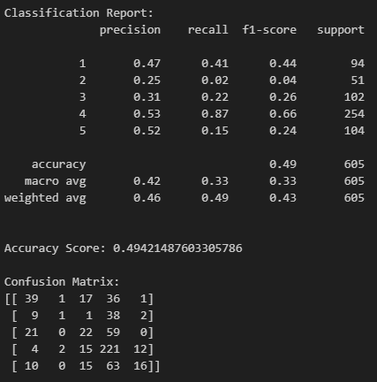
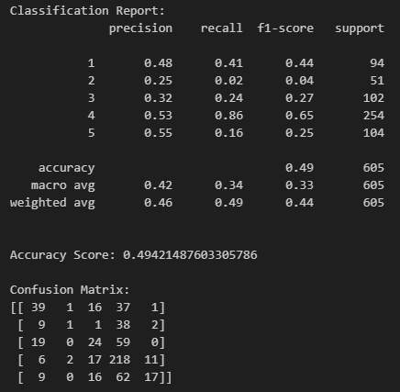
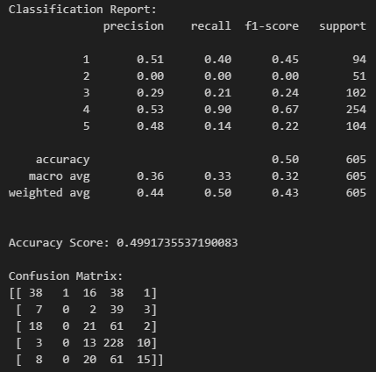
Random Forest
Without Pre-Processing:
Accuracy: 49%
Macro Average F1-Score: 33%
Weighted Average F1-Score: 43%
Post Feature Scaling:
Accuracy: 49% (no improvement compared to unprocessed data).
Slight improvement in F1-scores, especially for higher class labels.
Confusion Matrix Insights:
Class 4 (likely majority class) is predicted most accurately, with 218 correct predictions.
Misclassification is prominent for classes 2 and 3, indicating imbalance or overlapping features.
Without any Pre- Processing
Post Feature Scaling
Age Binning
Notes:
Key Pointers
Without Pre-Processing:
Accuracy: 49%
Macro Average F1-Score: 33%
Weighted Average F1-Score: 43%
Performance is limited due to lack of feature scaling, especially for features with different ranges.
Post Feature Scaling:
Accuracy: 49% (no improvement compared to unprocessed data).
Slight improvement in F1-scores, especially for higher class labels.
Highlights that scaling does not significantly impact Random Forest, as it is not sensitive to feature scaling.
Confusion Matrix Insights:
Class 4 (likely majority class) is predicted most accurately, with 218 correct predictions.
Misclassification is prominent for classes 2 and 3, indicating imbalance or overlapping features.
Overall Observation:
Random Forest struggles with imbalanced data and does not benefit much from feature scaling.

Slide 10
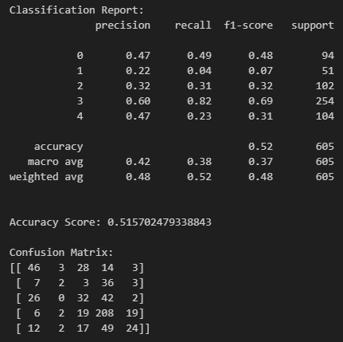
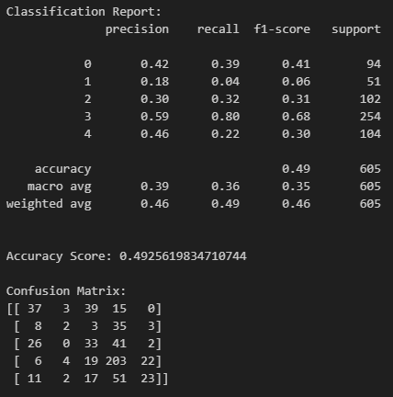
XGBoost
Post Age Binning:
Accuracy: Decreases slightly to 49%, with no significant improvement after age binning.
Class Performance:
Minimal changes in recall and precision across all classes, showing no significant effect of the age binning transformation.
Observation:
Binning features like age does not enhance the XGBoost model’s predictive performance.
Without Any Pre-Processing:
Accuracy: 52% overall, showing slightly better performance than Random Forest without scaling.
Confusion Matrix:
Significant misclassifications in classes 1, 2, and 4, likely due to class imbalance.
Without Any pre-processing
Post Age Binning
Post-Processing - No Effect
Notes:
Without Any Pre-Processing:
Accuracy: 52% overall, showing slightly better performance than Random Forest without scaling.
Class Performance:
Class 3 achieves the highest recall (82%) and F1-score (69%).
Classes 1 and 4 show the poorest recall and precision, reflecting challenges with minority classes.
Confusion Matrix:
Significant misclassifications in classes 1, 2, and 4, likely due to class imbalance.
Post Age Binning:
Accuracy: Decreases slightly to 49%, with no significant improvement after age binning.
Class Performance:
Minimal changes in recall and precision across all classes, showing no significant effect of the age binning transformation.
Macro Average F1-Score: 36%, indicating subpar balance across classes.
Observation:
Binning features like age does not enhance the XGBoost model’s predictive performance.
Key Takeaway:
XGBoost provides decent results but struggles with imbalanced classes. Further optimization, such as SMOTE or hyperparameter tuning, is needed to improve performance. Pre-processing methods like age binning did not significantly impact results.

Slide 11
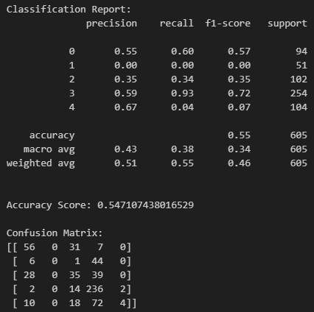
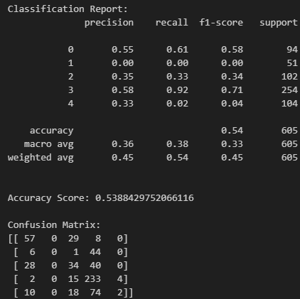
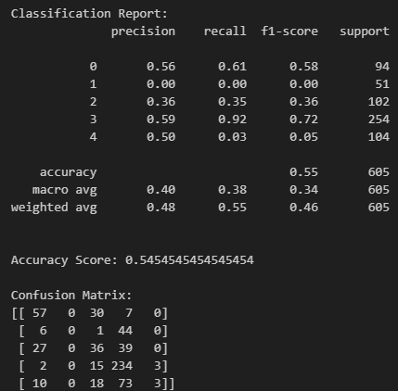
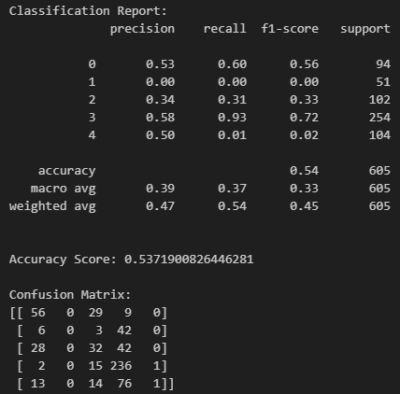
Logic Regression
Without Pre-processing
Post Binning
Accuracy: Slight drop to 54%.
Macro Average F1-Score: 33%, highlighting continued imbalance issues.
Accuracy: 54%, similar to full-feature training.
Focused feature selection does not significantly improve results, indicating more features might be relevant.
Post Scaling
Top 10 Features
Accuracy: 55%.
Best recall observed for Class 3 (93%), while Class 1 has zero recall, indicating poor handling of minority classes.
Accuracy: Maintains 55%, with minor changes in recall and precision.
Scaling shows limited impact due to the model’s insensitivity to feature scaling.
Notes:
Logistic Regression shows consistent results across preprocessing methods, but struggles with imbalanced classes. Techniques like SMOTE or feature engineering could improve performance.

Slide 12
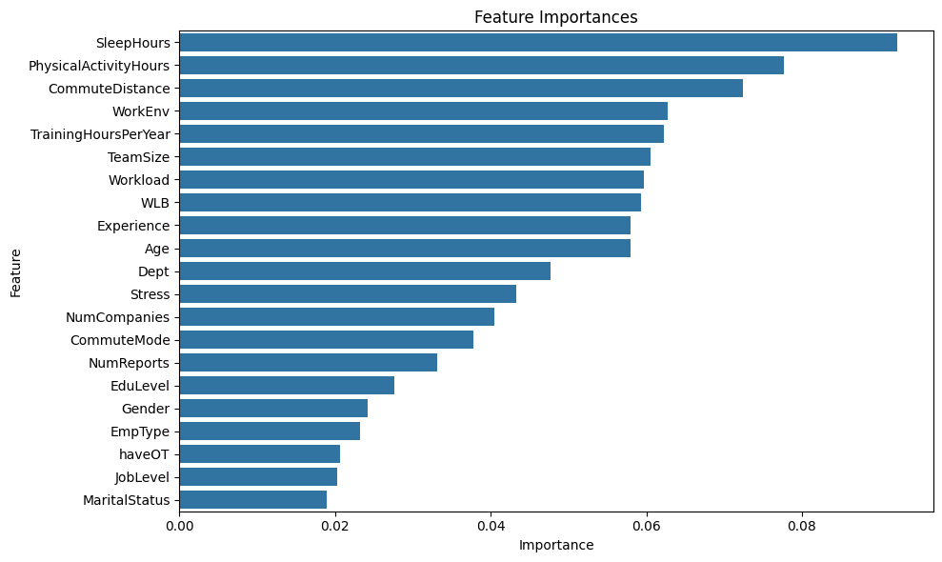
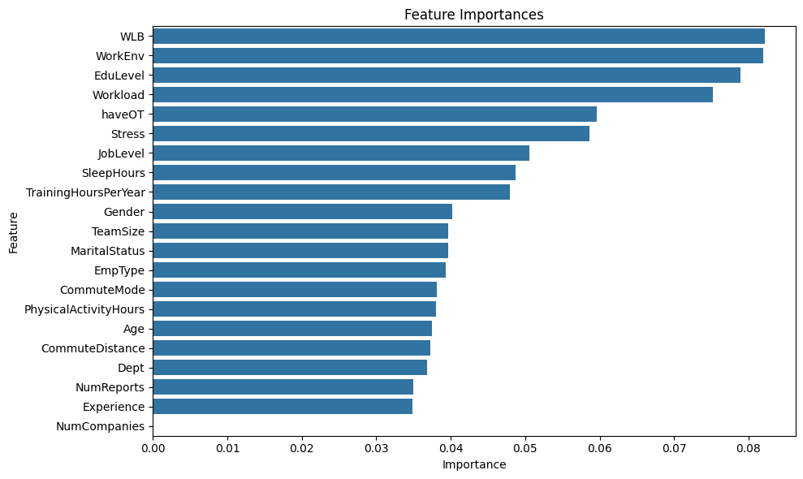
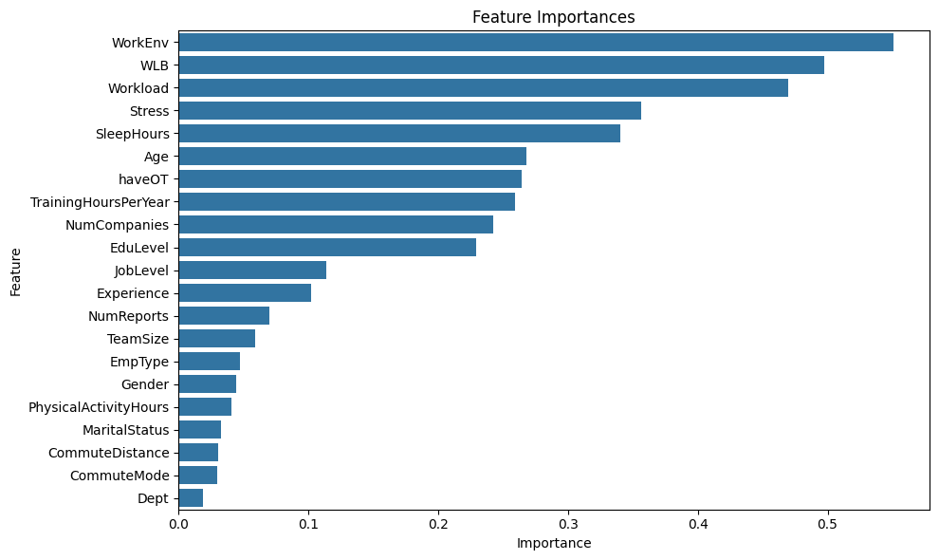
Feature Importance Comparison
Differences in secondary features suggest that ensemble methods (e.g., Random Forest, XGBoost) better capture nuanced predictors like physical activity and commute metrics.
Random Forest
XGBoost
Logistic Regression
All models agree on the significance of WorkEnv and WLB, indicating their strong impact on job satisfaction.
Notes:
Model-Specific Prioritization:
Random Forest emphasizes SleepHours, PhysicalActivityHours, and CommuteDistance as key predictors.
XGBoost gives higher importance to workplace factors like Work-Life Balance (WLB) and Work Environment (WorkEnv).
Logistic Regression also aligns with XGBoost, highlighting WorkEnv and WLB as primary factors.

Slide 13
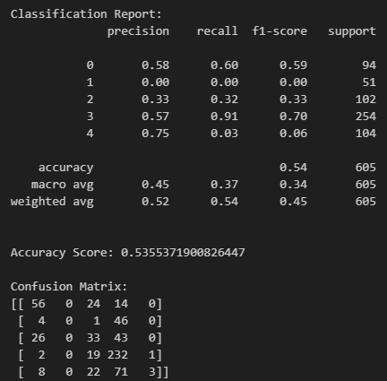
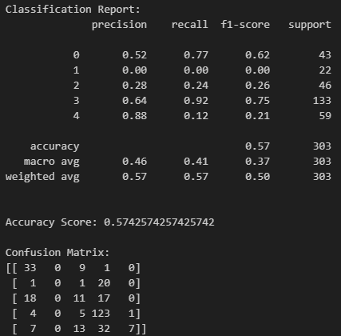
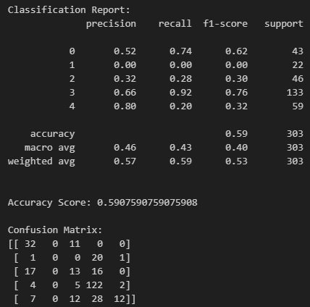
Support Vector Machine
Accuracy: 54%.
Class 3 performs the best with a recall of 91% and F1-score of 70%.
Classes 1 and 4 have poor recall due to imbalanced representation.
Accuracy: 57%, slight improvement due to balanced bins.
Class 3 maintains the highest recall (92%), while other classes show minor changes.
Accuracy: 57%, slight improvement due to balanced bins.
Class 3 maintains the highest recall (92%), while other classes show minor changes.
Without Any pre-processing
Post Binning
Top 10 Features

Slide 14
Analysis Results
Model Performance
XGBoost and Random Forest models outperformed others in feature importance and classification accuracy.
SVM showed moderate improvement with feature selection but struggled with imbalanced classes.
Logistic Regression provided stable results but lacked depth in capturing complex relationships.
Key Findings
Challenge Identified
Work-Life Balance and Work Environment are the strongest predictors of job satisfaction across all models.
Class imbalance hindered the models' ability to accurately predict lower satisfaction levels, affecting overall performance on minority classes.
Personal well-being factors like Sleep Hours and Physical Activity significantly impact satisfaction and stress levels.

Slide 15
Conclusion and Recommendations
01
Conclusion
Work Environment and Work-Life Balance emerged as consistent predictors of job satisfaction across models.
Personal well-being metrics, such as Sleep Hours and Physical Activity Hours, significantly contribute to reducing stress and enhancing satisfaction.
02
Recommendations for Organizations
Commute Distance negatively impacts job satisfaction, highlighting the importance of flexible work arrangements.
Enhance Work-Life Balance
Focus on Employee Well-being
Address Commute Challenges
Tailored Interventions for Career Phases
Data-driven Decision Making
Notes:
The analysis of job satisfaction among employees provides key insights into the factors influencing workplace happiness and productivity. Through detailed exploration and modeling using various techniques, including Random Forest, XGBoost, SVM, and Logistic Regression, the following conclusions were drawn:
Critical Factors for Job Satisfaction:
Work Environment and Work-Life Balance emerged as consistent predictors of job satisfaction across models.
Personal well-being metrics, such as Sleep Hours and Physical Activity Hours, significantly contribute to reducing stress and enhancing satisfaction.
Commute Distance negatively impacts job satisfaction, highlighting the importance of flexible work arrangements.
Challenges Identified:
Class Imbalance: Lower performance for minority classes (e.g., dissatisfaction levels) was a recurring issue across all models. This underscores the need for techniques like SMOTE to improve prediction accuracy.
Mid-career employees showed slightly lower satisfaction, suggesting challenges in this career phase that require targeted interventions.
Model Performance:
XGBoost and Random Forest consistently performed better in identifying key features, while SVM showed moderate accuracy improvement with feature selection.
Logistic Regression provided stable but less impactful results, emphasizing the importance of ensemble methods for complex datasets.
Recommendations
Enhance Work-Life Balance:
Develop flexible work policies and programs to support employees in managing personal and professional commitments.
Focus on Employee Well-being:
Invest in wellness initiatives, such as physical activity programs and sleep health campaigns, to reduce stress and improve satisfaction.
Address Commute Challenges:
Offer hybrid or remote work options to employees with longer commutes to boost overall satisfaction and productivity.
Tailored Interventions for Career Phases:
Provide career development programs, mentoring, and growth opportunities, particularly for mid-career employees.
Data-driven Decision Making:
Regularly monitor job satisfaction metrics and leverage predictive models to proactively identify and address areas of dissatisfaction.
Resolve Class Imbalance in Future Analyses:
Incorporate advanced resampling techniques, such as SMOTE, to improve model accuracy for underrepresented satisfaction levels.
This analysis emphasizes the importance of personalized, data-driven approaches to enhance job satisfaction, which directly impacts employee retention and organizational success.

Slide 16

Thanks！

